Slide 1
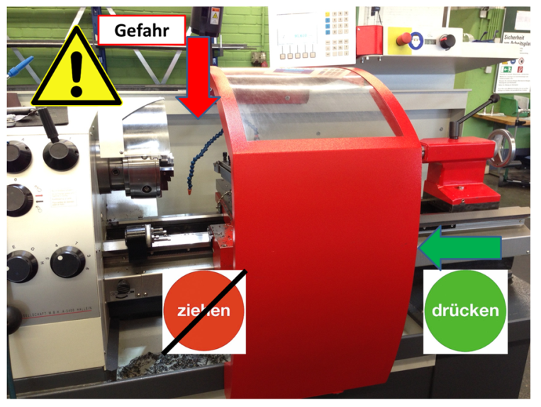
HS&E INCIDENT BULLETIN |  | 2nd Quarter 2013
Location Germany | Type of incident : cutting damage
Summary:
A flow chip at a turning machine hits the left hand of an employee due to the wrong handling of the protection cover.
Root Causes: | Actions Taken Thus Far: Next Steps
Operator detected flow chip and tried to shut off driving of cutter. Arm was behind cover and operator moved cover with wrong hand to wrong side. Hand enters hazardous zone of chuck and operator was hurt by flow chip . | Continuous training of correct handling of protection cover and save shut-down in case of flow chips. Improved awareness of operators about possible dangers while working on conventional turning machines.

